Slide 1


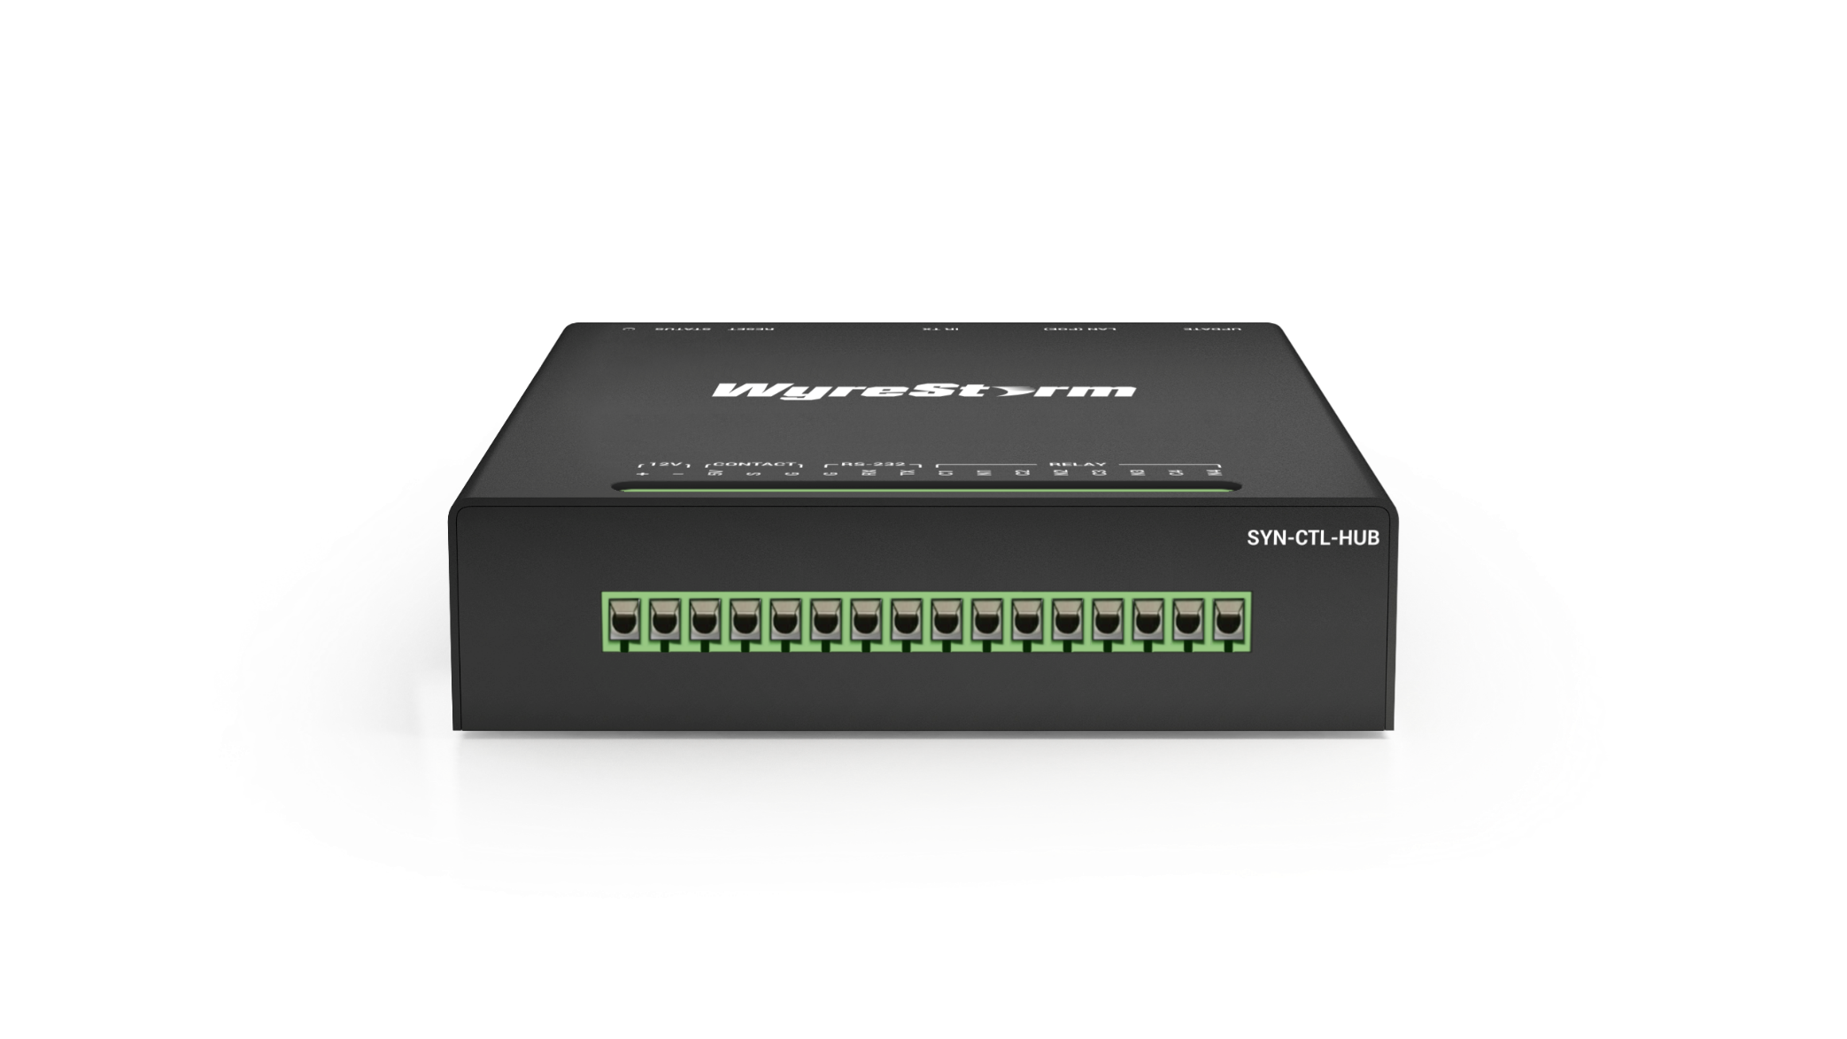
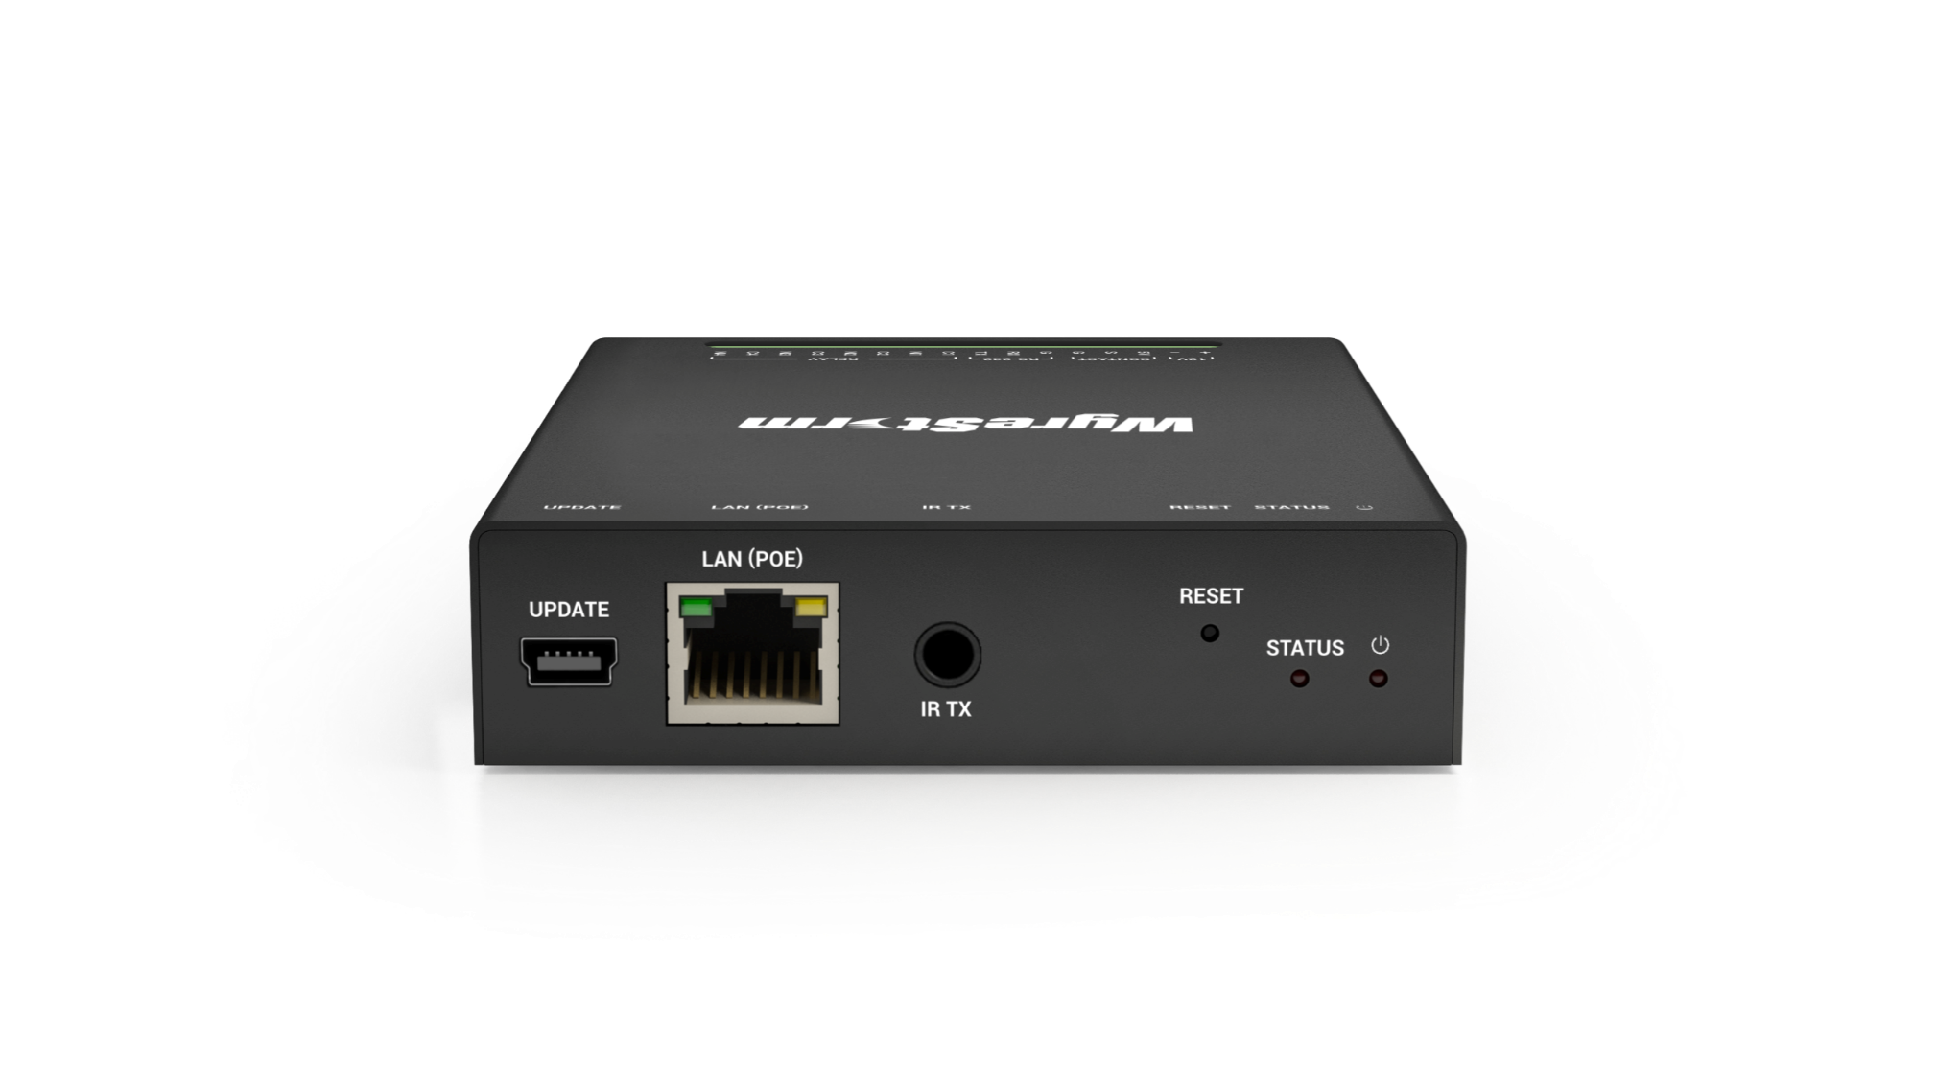

SYN-CTL-HUB
Product Guide
A Compact and Versatile Protocol Converter
(Specifically used with Controllers)
Award-Winning Audio-Visual Solutions Manufacturer
Notes:
1. 更新封面，不需要展示产品；

Slide 2

Contents
Product Overview
Interface & Specifications
Typical Connection & Applications
Competitor Analysis
Q & A Session
Powerful · Reliable · Simple

Slide 3
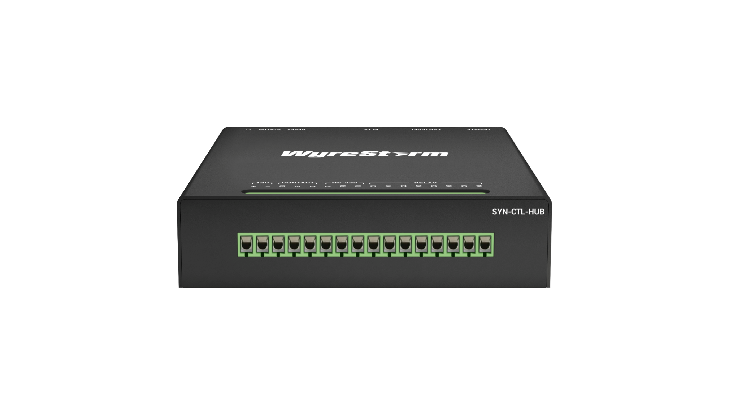
Product Overview
A Compact & Versatile Protocol Converter
SYN-CTL-HUB is a compact, cost-effective protocol converter that converts IP signals into RS232, Infrared, and Relay protocols. Designed for seamless integration in space-constrained environments, it supports PoE, flexible mounting, and essential control protocols with external trigger detection. Its scalability ensures compatibility with third-party control platforms like Crestron and AMX, making it ideal for AV and automation applications.
Powerful · Reliable · Simple

Slide 4
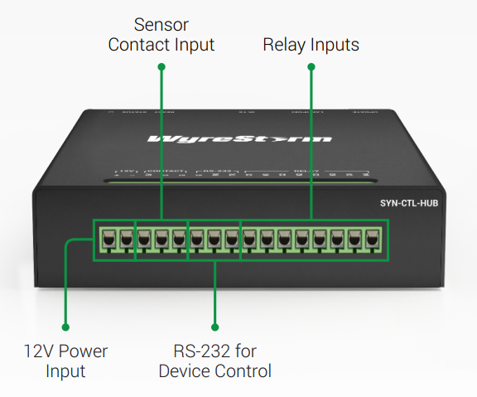
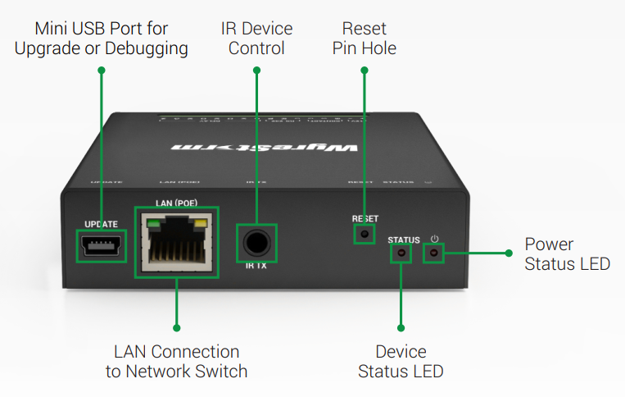
Interface of the Product
Featuring:
DC 12V Power Input:
Simple power connection for easy setup.
RS-232 Ports for Device Control:
Reliable control interface for seamless device integration.
Ethernet Port with PoE:
Single cable for power and data transfer, simplifying installation.
IR Emitter:
Enables infrared control for compatible devices.
Front Panel
Rear Panel
Powerful · Reliable · Simple

Slide 5
Specifications & Packing List
Main Specifications
 | Wyrestorm SYN-CTL-HUB | Notes
Dimension (W x H x D) | 82mm x 20mm x 91mm
Power | DC 12V & PoE | DC 12V or PoE 802.3af & 802.3at
LAN | x 1 (PoE) | 10/100 Mbps
RS232 | x 1 (RS232) | 115200
IR | x 1
Relay | x 4 | 30 VAC/VDC, 2 A
CONTACT IN | x 1
What’s in the Box?
1x SYN-CTL-HUB
2x Mounting Brackets (with Screws)
1x IR Emitter
1x Quick Start Guide
Powerful · Reliable · Simple

Slide 6
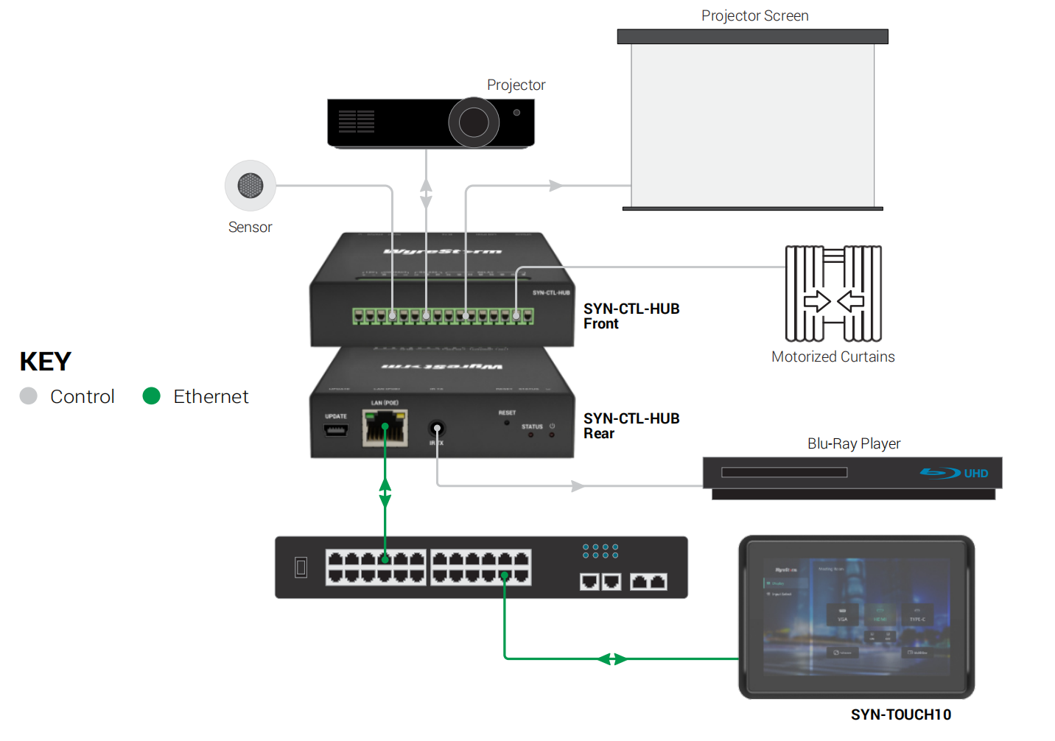
Typical Connection & Applications
Basic control and equipment connection network diagram：

Slide 7
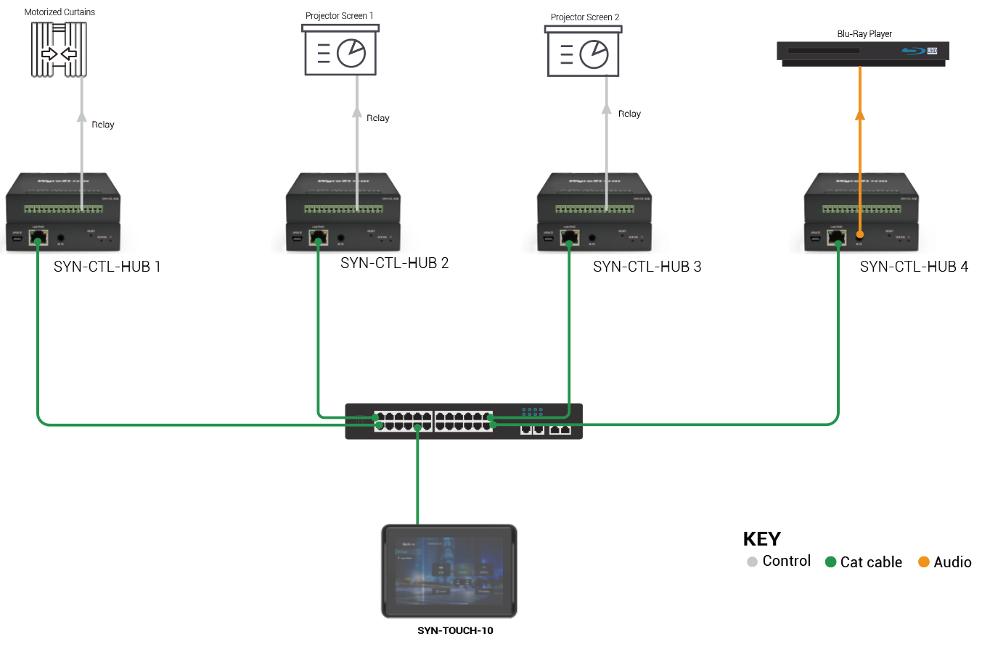
Typical Connection & Applications
Key Benefits Include:
As a controller, SYN-CTL-HUB cooperates with Touch10 to control external devices through RS232, IR, Relay, etc.
Expand the range of control devices of SYN-TOUCH10.
Power over POE simplifies installation by combining power and data in a single cable. Reduces the need for additional power supplies.

Slide 8
Comparison with Other Competitors
 | Wyrestorm SYN-CTL-HUB | Crestron CP4 | Extron IPCP Pro 550
Dimension (W x H x D) | 82mm x 20mm x 91mm | 439mm x 44mm x 167mm 1 RU 19-in. | 221mm x 43mm x 267mm 1 RU 19/2-in
Power | DC 12V & PoE | DC 24V | AC 100~240V
LAN | x 1 (PoE) | x 1 | x 1
RS232 | x 1 (RS232) | x 3 (RS232/422/485) | x 6 (RS232) x 2 (RS232/422/485)
IR | x 1 | x 8 | x 8
Relay | 30 VAC/VDC, 2 A x 4 | 30 VAC/VDC, 1 A x 8 | 24 VDC, 1 A x 8
I/O | x 1 CONTACT IN | x 4 | x 4
DC power output | x 0 | x 0 | x 4
MSRP | $195.00 | / | /
Powerful · Reliable · Simple

Slide 9
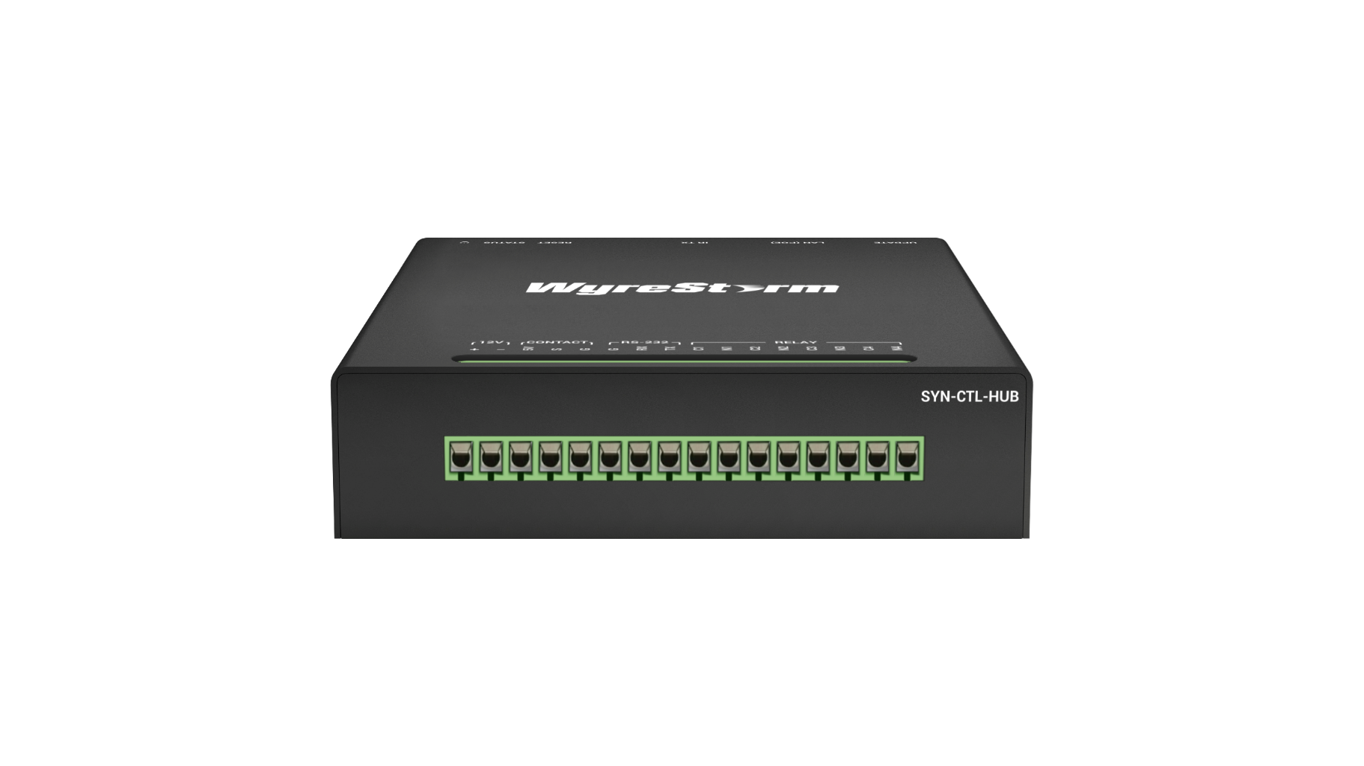

Our Advantages
Our Key Advantages Include:
Compact Design:
Space-saving form factor ideal for limited installation spaces.
Affordable and user-friendly, perfect for small-scale applications.
Power over Ethernet (PoE):
Simplifies installation by delivering power and data through a single cable.
Reduces the need for additional power adapters, enhancing deployment efficiency.
Comprehensive Control Protocols:
Supports key control standards for broad device compatibility.
CONTACT IN functionality enables external triggers from sensors or switches.
Scalability and Integration:
Seamlessly integrates with SYN-TOUCH10 for enhanced control.
Compatible with third-party systems like Crestron and AMX for scalable deployment.
Powerful · Reliable · Simple

Slide 10

Final Thoughts
Q & A Session
Got questions? Don’t hesitate to ask away.
Powerful · Reliable · Simple

